Slide 1

-The internet of things-
How has programming changed our lives ?
Sofian EON
Arthur MURILLO
Xabi Avellan

Slide 2
Table of contents
Definition
Timeline
Present day
Future ?
Conclusion

Slide 3
Timeline

Slide 4
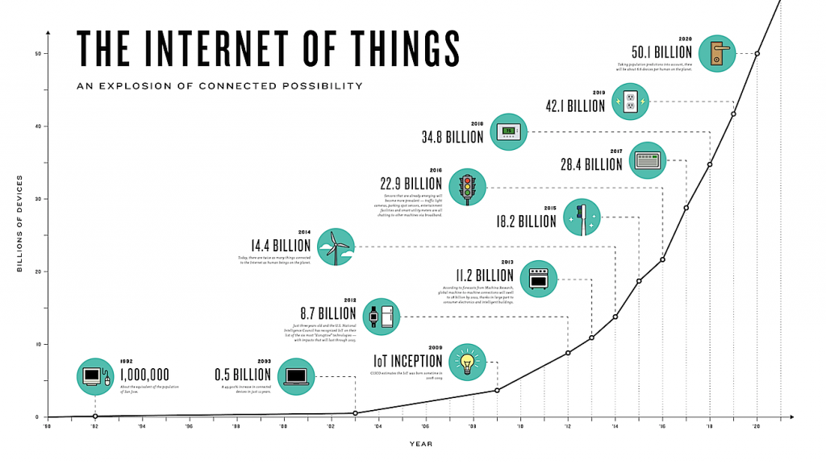

Slide 5
Present day

Slide 6
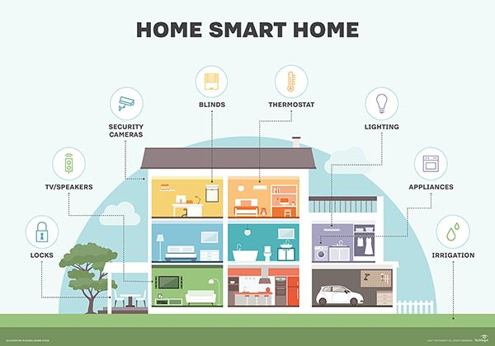
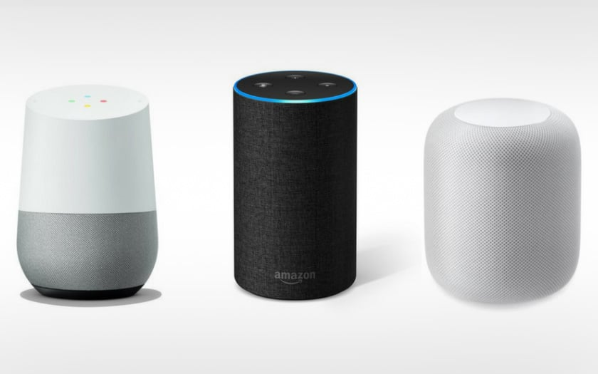
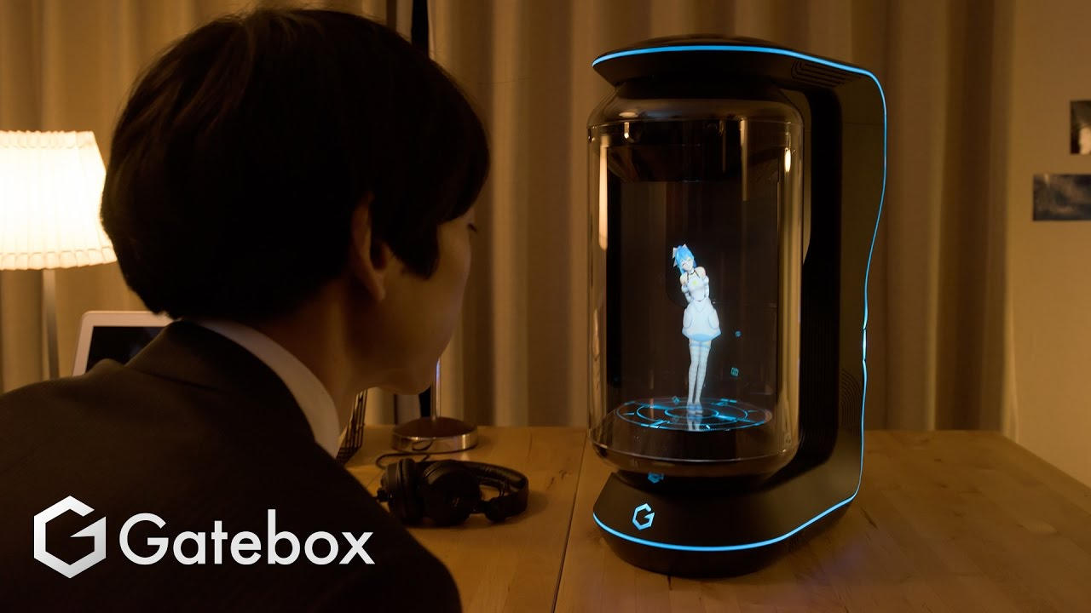

Slide 7
Future ?

Slide 8
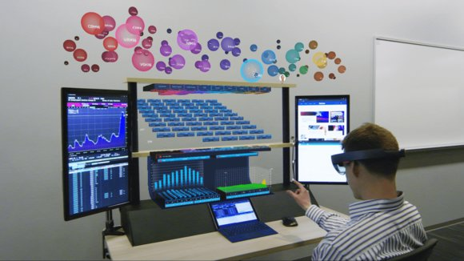
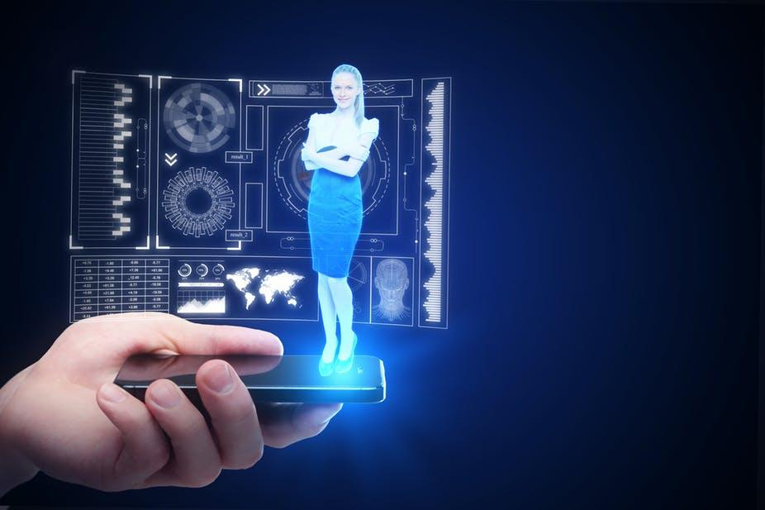

Slide 9
Conclusion

Slide 10
Thank you for listening !
Feel free to ask any question

